Slide 1

Sapphire Fibres Limited
Corporate Briefing Session 2025

Slide 2
Contents
01 | Sapphire Fibres Limited Introduction
02 | Strategic / Operational Developments
03 | Historical Financial Highlights
04 | Financial Results 2025
05 | Future Outlook
06 | Q & A Session

Slide 3
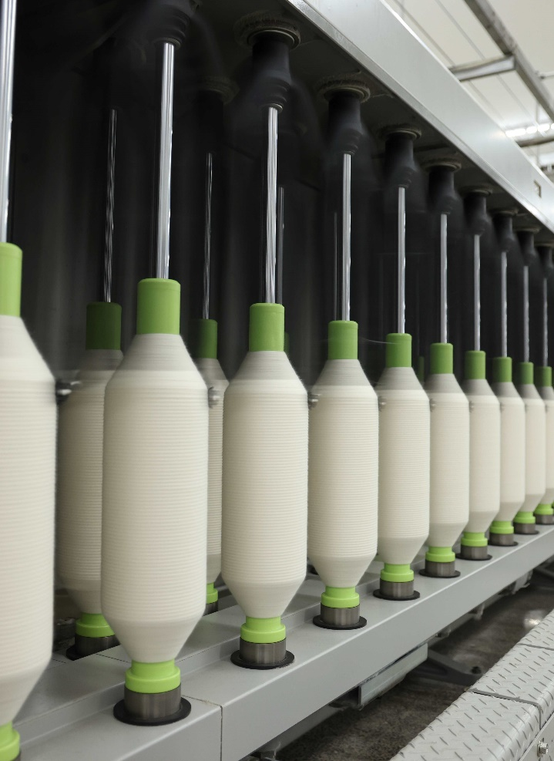
01
Sapphire Fibres Limited Introduction

Slide 4
Introduction
Vision
Mission
To be one of the premier textile company recognized for leadership in technology, flexibility, responsiveness and quality. Our customers will share in our success through innovative manufacturing, certifiable quality, exceptional services and creative alliances. Structured to maintain in depth competence and knowledge about our business, our customers and worldwide markets.
Our workforce will be the most efficient in industry through multiple skill learning, the fostering of learning and the fostering of teamwork and the security of the safest work environment possible recognized as excellent citizen in the local and regional community through our financial and human resources support and our sensitivity to the environment.
Our mission is to be recognized as premier supplier to the markets we serve by providing quality yarns, fabrics and other textile products to satisfy the needs of our customers. Our mission will be accomplished through excellence in customer service, sales and manufacturing supported by teamwork of all associates. We will continue our tradition of honesty, fairness and integrity in relationship with our customers, associates, shareholders, community and stakeholders

Slide 5




Introduction :
Sapphire Fibres Limited (SFL) was incorporated in Pakistan on 05 June 1979 as a public limited company. The shares of the company are listed on Pakistan Stock Exchange. SFL is principally engaged in manufacturing and sales of yarn, fabrics and garments.
Sapphire Electric Company Limited (SECL), which is subsidiary of SFL owns & operates a combined cycle power plant. SECL has a Power Purchase Agreement with its sole customer, National Transmission & Dispatch Company Limited for thirty years which commenced from October 05, 2010.
Yarn
Denim Fabric & Garments
Knited Fabric & Garments
Power Plant
107,424 Spindles
63,249,866 Lbs
20,400,000 Meters
600,000 Pieces
13,812,440 Lbs
9,600,000 Garments
212 MW Power Plant

Slide 6
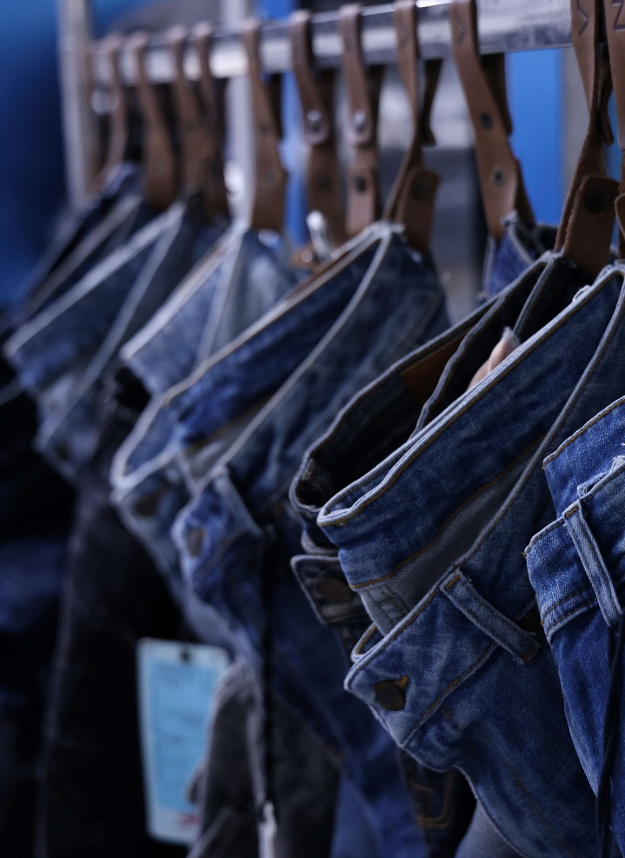
02
Strategic / Operational Developments

Slide 7
Strategic / Operational Developments
Spinning Division:
Denim Fabric
The Company during the year has invested Rs. 2,626 million on On-Grid Solar-PV System 6.5 MW, Ring Spinning Frames, Air Conditioning Plant, Doubling Machine, Lycra Attachments, Xorella Machines, Volkman Two for one Twister, Jossi Vision Sheild, Link Coner Savio Polar Uster Quantum, Simplex, Drawing Machines and Link Coner Murata Automatic Coner in spinning Division
During the year, investment of Rs. 51 million on Dust & removal system for weaving and Cone winding machine with 400 Ends Chine in Denim Division has been made.
Denim Apparel
The Company entered in new segment of business i.e. Denim Apparel. During the year, Rs.672 million invested in Machinery and buildings.
The Company invested Rs.168 million in its Knits Division to add cheaper sources of utilities.

Slide 8
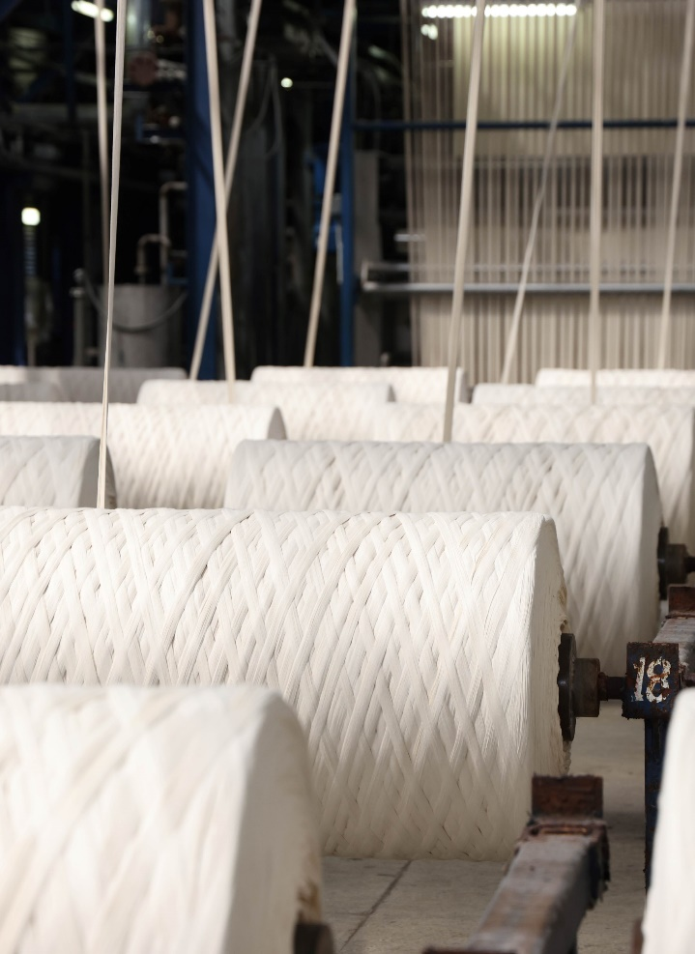
03
Historical Financial Highlights

Slide 9
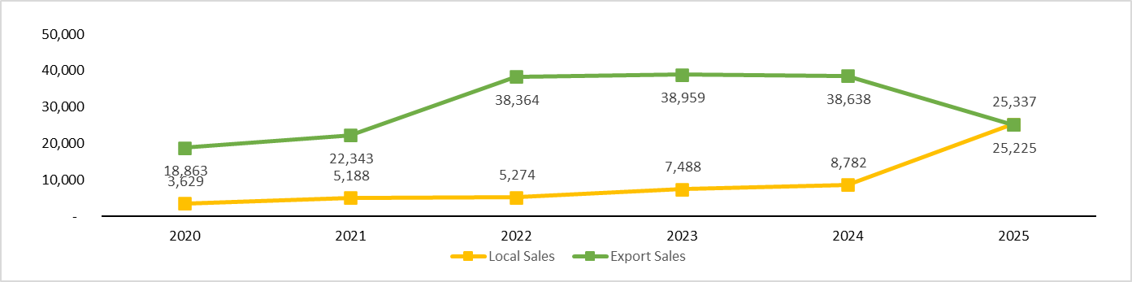
Sales

Slide 10
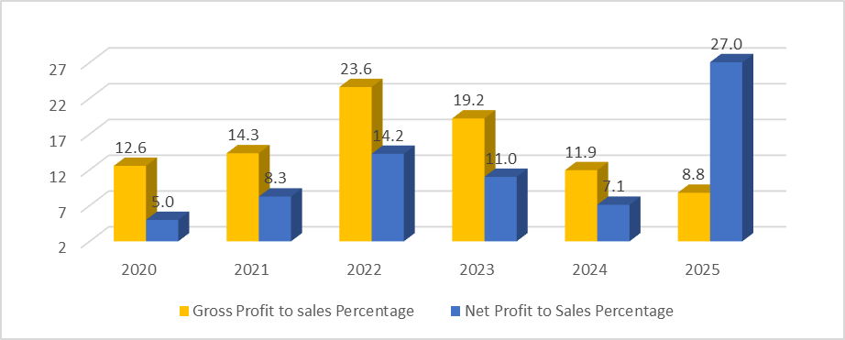
Profits to Sales

Slide 11
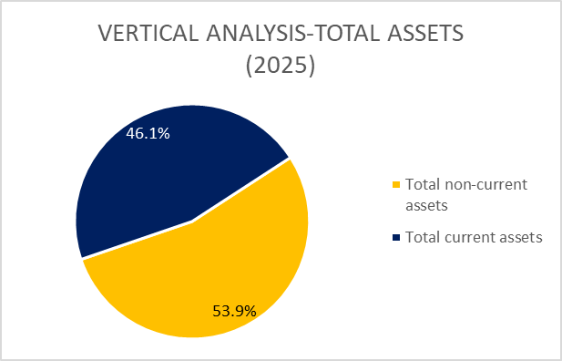
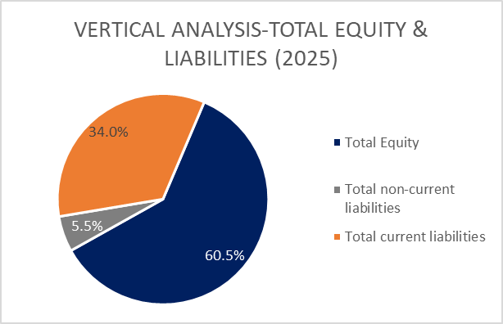

Slide 12
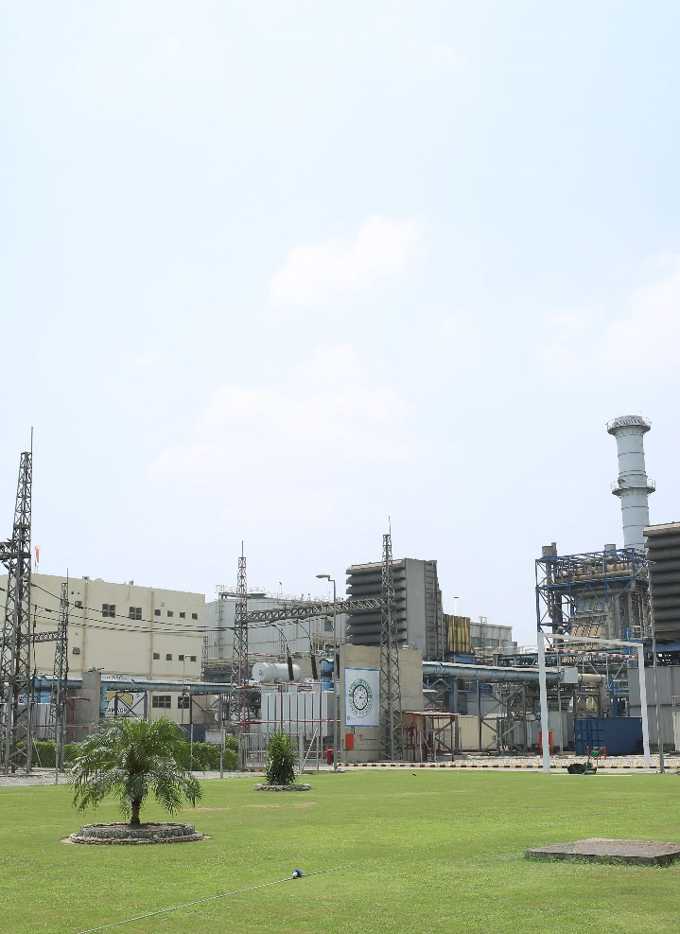
04
Financial Results 2025 vs 2024

Slide 13
Key Highlights
Net Profit
305.5%
Sales
6.6%
Current Ratio
22.4%
Dividend
(100%)
Break-up Value
46.5%
Return on equity 17.2%

Slide 14
Statement of Value Addition and its Distribution

Slide 15
Consolidated Income Statement

Slide 16
Balance Sheet Assets
2025
83,669 Million
2024
56,276 Million
18,752 million (23%)
Property, plant and equipment
16,045 million (29%)
30,820 million (37%)
Long term and short-term investments
13,097 million (23%)
19,307 million (23%)
Stores and stocks
16,173 million (29%)
5,728 million (7%)
Trade Debts
5,596 million (10%)
3,443 million (4%)
Taxes refund due form Government
2,137 million (4%)
5,619 million (6%)
Other assets
3,228 million (5%)

Slide 17
Balance Sheet Equity & Liability
2025
83,669 Million
2024
56,276 Million
50,614 million (60%)
Shareholders Equity
34,560 million (61%)
5,553 million (6%)
Total Long-term Liabilities
5,596 million (10%)
6,004 million (7%)
Trade Liabilities
6,120 million (11%)
16,389 million (20%)
Short Term borrowings
8,117 million (14%)
4,808 million (6%)
Provision for Taxation
1,669 million (3%)
301 million (1%)
Other Liabilities
214 million (1%)

Slide 18
Consolidated Balance Sheet – Assets
 | 2025 | 2024
 | Rs. (Million) | Rs. (Million)
Property, plant and equipment | 28,512 | 26,263
Long and short term investments | 58,800 | 12,818
Stores and stocks | 19,615 | 16,492
Trade debts | 8,227 | 17,716
Cash and banks | 2,274 | 1,832
Other assets | 8,959 | 6,379
Total | 126,387 | 81,500

Slide 19
Consolidated Balance Sheet – Equity & Liabilities
 | 2025 | 2024
 | Rs. (Million) | Rs. (Million)
Equity of parent shareholders | 84,697 | 48,401
Non-controlling interest | 5,949 | 7,032
Long term liabilities | 5,602 | 5,596
Trade liabilities | 8,563 | 9,313
Short term borrowing | 16,460 | 9,149
Taxation | 4,814 | 1,671
Other liabilities | 302 | 338
Total | 126,387 | 81,500

Slide 20
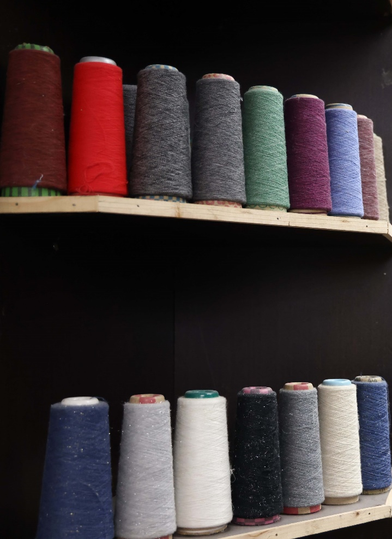
05
Future Outlook

Slide 21
Future Outlook
Pakistan’s economy commenced fiscal year 2025-26 on a positive trajectory, leveraging the improvements achieved in the preceding year. The stronger external and fiscal position provides a firm foundation for continued stability and growth.
A supportive global environment, coupled with stronger demand from trading partners and Pakistan’s recent trade deal with the United States, is expected to drive export growth. Concurrently, steady remittance inflows are expected to balance import pressures linked to tariff rationalization.
The Management remains dedicated to strengthening the Company’s future by driving innovation across our product portfolio and introducing new business segments. Strategic focus on enhancing operational efficiency and maintaining financial discipline will support these initiatives, enabling the Company to stay ahead of evolving market needs, and deliver sustained value to our shareholders.
SAPPHIRE

Slide 22
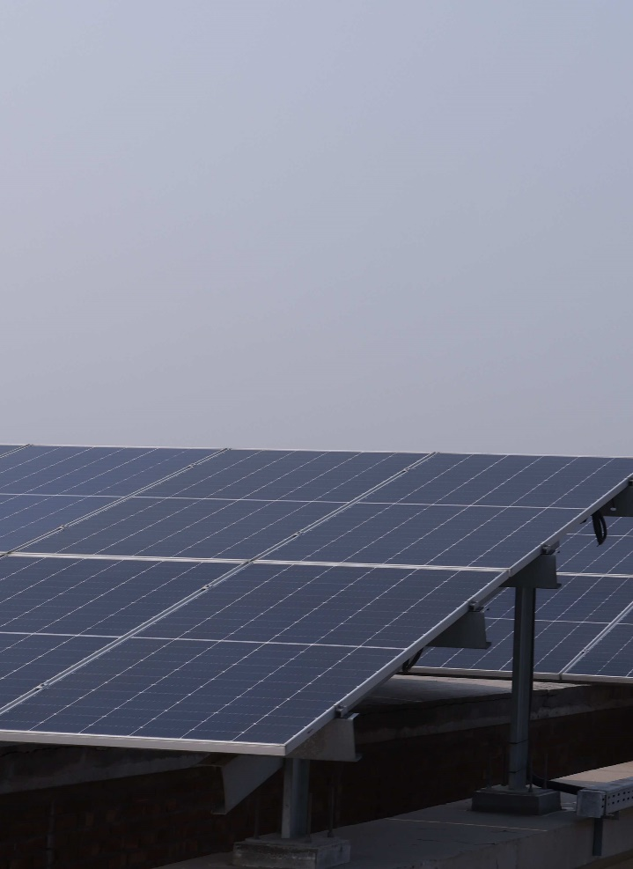
06
Q & A Session

Slide 23
Thanks!

